Slide 1
IO

Slide 2
Content
Java.io API
Files and directories
Read and write – console
BufferedReader/-Writer
Files
Streams

Slide 3



Files and directories
File system: hierarchically organized files and directories
File: record in a file system with data
Directory: record in a file system containing files and other directories
Root directory: top directory in the file system
Windows: c:\ (or another letter)
Linux: /
Different OS use different file systems
Path: String representation of a file/directory

Slide 4

File class
Java class in the java.io API
Instance of a File object has a pathname of a file/directory in the file system
Used to read information about files and directories, but cannot read content of file
Such as list contents
Create/delete files/directories

Slide 5

File class
File object is initialized with a path:
Absolute: looking from the root of the file system (start with root)
Relative: looking from the current directory
File separator might differ for OS, can be requested by:
System.getProperty(“file.separator”)
java.io.File.separator
Creating a file:
File file = new File(“/home/directory/file.txt”);
Notes:
Method and static variable to get file separator

Slide 6
Methods in the file class
exists()
getName()
getAbsolutePath()
isDirectory()
isFile()
length() > returns nr of bytes in file
lastModified()
delete()
renameTo(File)
mkdir() > create directory named by path
mkdirs() > create directory and nonexisting parent directories
getParent() > parent directory
listFiles() > returns File[] in directory

Slide 7
Exercise
Use Java to:
Create a new folder “example”
Add a file “log.txt” to this folder
Add a folder “messages” to the folder example
Create a txt file for messages in this folder
Print the pathname of the messages.txt to the console
Verify both files exist
Verify whether example/nothere.txt exists

Slide 8
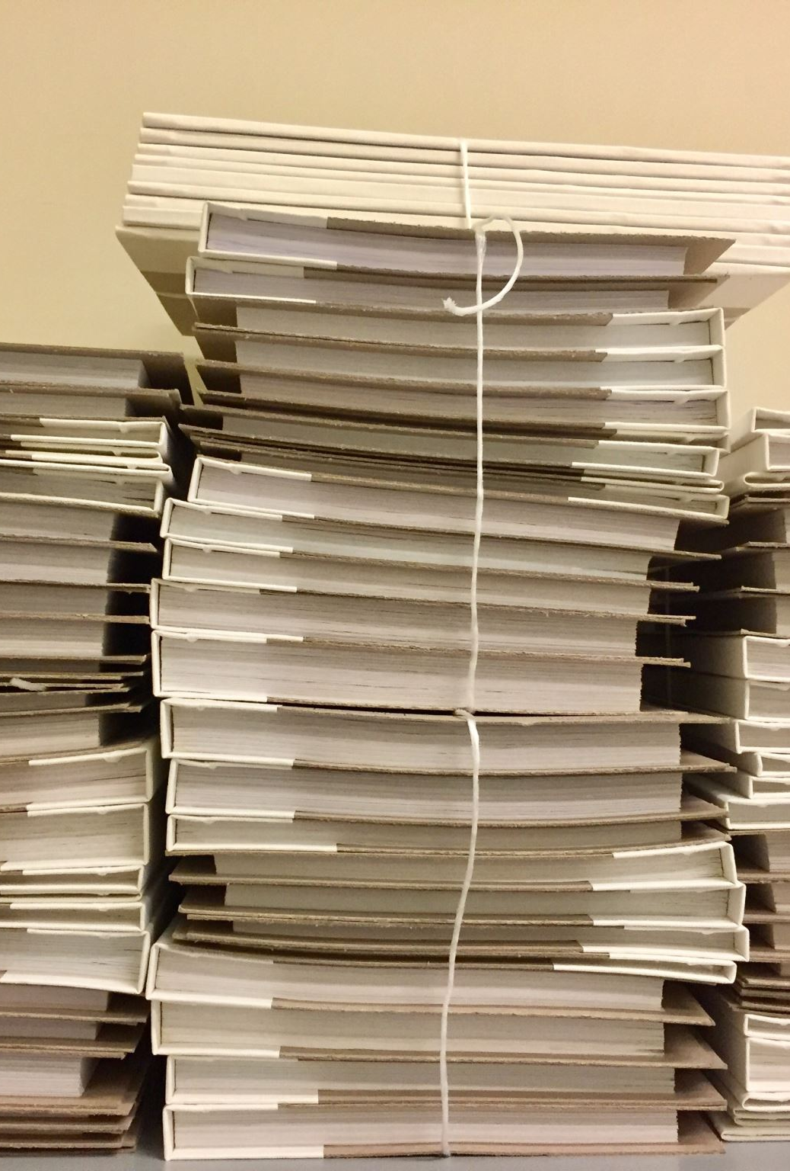
I/O Streams
Input/output streams
Input: reading
Output: writing
Not related to the Stream API
Files can be read or written using a stream.
Stream is a long list of sequential data elements in the file
Data is read/written one chunk of the list at time
Notes:
Chunk of data that can be read at a time depends on the memory of the computer

Slide 9

I/O Streams
Very many different streams: streams that read bytes, character, strings, groups of bytes etc
Most streams in the java.io API work with (arrays of) bytes at a time
Used for processing and writing to files, but also for sequential data source
Example of output stream: System.out
Very many different streams in java.io API
Notes:
Chunk of data that can be read at a time depends on the memory of the computer

Slide 10

Byte vs character stream
Byte: classes with the word stream in it
Character: classes with the word reader/writer in it
Different way of reading the stream
Byte: used for reading/writing all binary/byte data
Character: used for reading/writing string/character data
Technically, you can always use byte streams (because Strings fit in).
Character streams are for convenience, no need to mind byte encoding of files

Slide 11

Input and output
Stream classes with the word input are paired with a class with a similar name but output instead of input
E.g. FileInputStream and FileOutputstream
The data that is written by a specific inputstream can be read with the almost-same-name outputstream
Same is true for reader and writer
E.g. FileReader and FileWriter
Notes:
Exception: printwriter has no corresponding printreader class
And printstream has no corresponding inputstream class

Slide 12
Low vs high level
Low level: directly connects with the source (e.g. file, array, string)
High level: built on top of another stream; constructor of this high level stream takes a low level stream
E.g.: new BufferedWriter(new FileWriter(“messages.txt”)) > could be any subclass of abstract class Writer as input
Best practice: use Buffered class when you don’t need to do something specific that requires you to read a byte at a time, it increases performance

Slide 13
Java.io stream classes
Base classes: 4 abstract classes that are the parents of all stream classes in java.io
InputStream
OutputStream
Reader
Writer
Child classes have the parent name as a suffix
High level classes take the abstract class as input parameter for their constructor

Slide 14

Exercise
Add some text to your file messages.txt
Read this file and write the content to log.txt using the most appropriate stream class
Try it with: byte and character stream, high level vs low level
Bonus: reverse the content
Bonus: how to reverse the content when the file is huge?

Slide 15
Stream operations
Close
close() > used to close a stream, automatically called after try-with-resources
Flush
flush() > writes al data to disk immediately, delays application but avoids data loss if program crashes before cache is written to file system
Mark
mark(int x) > if a stream supports mark, you can call mark with an integer. This integer represents after how many bytes further you can still revert to that point when you call reset() on the stream
Skip
skip(long l) > skips the specified number of bytes
Read
read() and write()

Slide 16
Exercise
Close
Mark
Create a new file “close.txt”
Write to this stream using a try block, make sure the program doesn’t terminate
Don’t close the stream
What do you think will happen if you try to open close.txt and modify it manually
And why?
Create an inputstream
Use the smalles number of initial values to achieve “trolololol” using mark and reset

Slide 17
Stream classes
FileInputStream and FileOutputStream
BufferedInputStream and BufferedOutputStream
FileReader and FileWriter
BufferedReader and BufferedWriter
ObjectInputStream and ObjectOutputStream

Slide 18

Example of each stream pair
Take 15 minutes to prepare a 2 minute explanation + demo of one of the stream pairs of the previous slide.

Slide 19
What stream to use?
A: You want to read from a file with default character encoding
B: You want to read from a inputstream
C: To serialize your custom Car object
D: Read from a file with special character encoding
Notes:
A: filereader
B: BufferedReader
C:ObjectOutputStream
D: FileInputStream

Slide 20

Serializable interface
Serializing: converting object to stored data format
Deserializing: converting stored data to object
Marker interface
Class that can be serialized implements serializable interface
Empty interface, so no methods need to be implemented
When a class implements serializable it means that the developer has ensured that the class can be serialized, so all instance variables in class and all nested instance variables must also be serializable, unless it’s marked transient (then it will be skipped during serializing)
Static members are ignored during serializing
Good practice to keep the version in a serialVersionUID of the serializable object, so that deserializing an old data version to the new version can be prohibited to avoid exceptions

Slide 21

Question exercise
If static members are ignored, then why a static version id that is saved serializing the object?
Notes:
serialVersionUID is a special static variable used by the serialization and deserialization process, to verify that a local class is compatible with the class used to serialize an object. It's not just a static variable as others, which are definitely not serialized.
When an object of a class is first serialized, a class descriptor containing among other things the class name and serial version UID is written to the stream. When this is deserialized, the JVM checks if the serial version UID read from the stream is the same as the one of the local class. If they're not, it doesn't even try to deserialize the object, because it knows the classes are incompatible.

Slide 22
Serializing and deserializing objects
Can be done with ObjectInputStream and ObjectOutputStream
ObjectOutputStream has a method writeObject(Obj) to serialize the object
ObjectInputStream can convert data to an object using readObject; result needs to be casted to desired object
Exercise: try to serialize an object that doesn’t implement the Serializable interface; what happens? Fix it ☺

Slide 23

Exercise
Create a new class Animal, give it some properties, make it serializable
Create an instance and serialize it and save to a file
Read the instance and deserialize it
What exceptions do you need to catch?
What happens if you make some variables static? And transient?
Notes:
public static void main(String[] args) throws IOException, ClassNotFoundException { class SerializeMe implements Serializable { String name; } SerializeMe s = new SerializeMe(); s.name = "lalala"; ObjectOutputStream o = new ObjectOutputStream(new BufferedOutputStream(new FileOutputStream(new File("test.txt")))); o.writeObject(s); o.close(); ObjectInputStream o1 = new ObjectInputStream(new BufferedInputStream(new FileInputStream(new File("test.txt")))); SerializeMe s1 = (SerializeMe) o1.readObject(); o1.close(); System.out.println(s1.name); }

Slide 24

Object creation
When object is being deserialized and created, the first no-argsnon serializable constructor in the inheritance line is taken and static members and default initializations are ignored for transient and static members

Slide 25

PrintStream and PrintWriter
High level stream classes
Write representation of Java objects to text output stream
PrintStream: writes as bytes
PrintWriter: writes as characters
No reader/input associated with it

Slide 26

Old way of user interaction
Creating a BufferedReader, with as argument a InputStreamReader, with as argument System.in
Calling readLine() on the BufferedReader and capturing this in a String so something can be done with the input

Slide 27
New way of user interaction
Console class (singleton)
Uses reader/writer instead of inputstream/outputstream
Has methods for convenience
writer() and reader() return access to instance of Reader and PrintWriter
Console.writer().println > does the same as System.out.println
format() (= printf()) > String format with arguments
flush()
readLine()
readPassword() > user doesn’t see text that is being entered on the screen

Slide 28
Exercise
Create a small console application using the new way
Ask the person for a username
Ask the person for a password
Write these to a file.
You may need to run your application from cmd line for this
Bonus/alternative: make a much cooler console application, like snake, or tic tac toe, or..? Write the actions of the user to a file.
Notes:
https://stackoverflow.com/questions/23980983/my-java-console-is-not-working

Slide 29

IO exercises
If you want extra practice, take these exercises:
https://www.cosc.brocku.ca/mentor/javaio_tutorial

Slide 30
Case
Write the transport information to a file, so who or what moved from where to where and when
Have another method read this file and monitor this output for any products that should have a license but didn’t have (a valid) one. Write these to a separate file so the moon police knows what illegal transportations took place
Make your moon administration serializable
Ask the user for input on this administration
Upon ending the console app, write it to a file
Open it when the user later wants to continue a previous session

